Slide 1
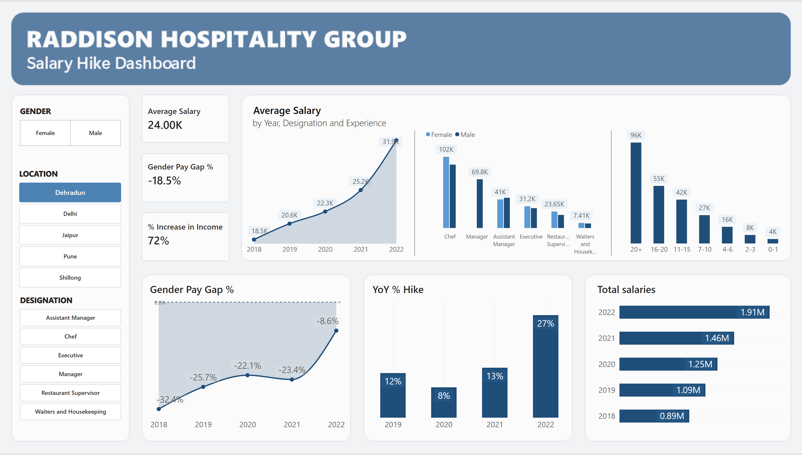
Dashboard
Notes:
lineChart
No alt text provided
YoY % Hike
No alt text provided
Gender Pay Gap %
No alt text provided
Total salaries
No alt text provided
clusteredColumnChart
No alt text provided
Average Salary
No alt text provided
cardVisual
No alt text provided
cardVisual
No alt text provided
cardVisual
No alt text provided
textbox
No alt text provided
shape
No alt text provided
shape
No alt text provided
advancedSlicerVisual
No alt text provided
advancedSlicerVisual
No alt text provided
advancedSlicerVisual
No alt text provided

Slide 2
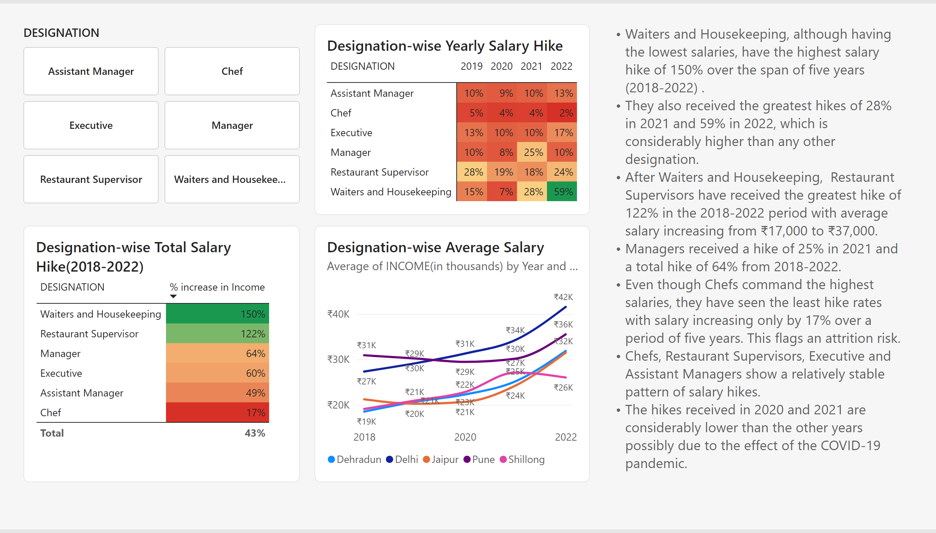
Designation-wise Salary Hike
Notes:
Designation-wise Average Salary
No alt text provided
Designation-wise Yearly Salary Hike
No alt text provided
Designation-wise Total Salary Hike(2018-2022)
No alt text provided
advancedSlicerVisual
No alt text provided
textbox
No alt text provided

Slide 3
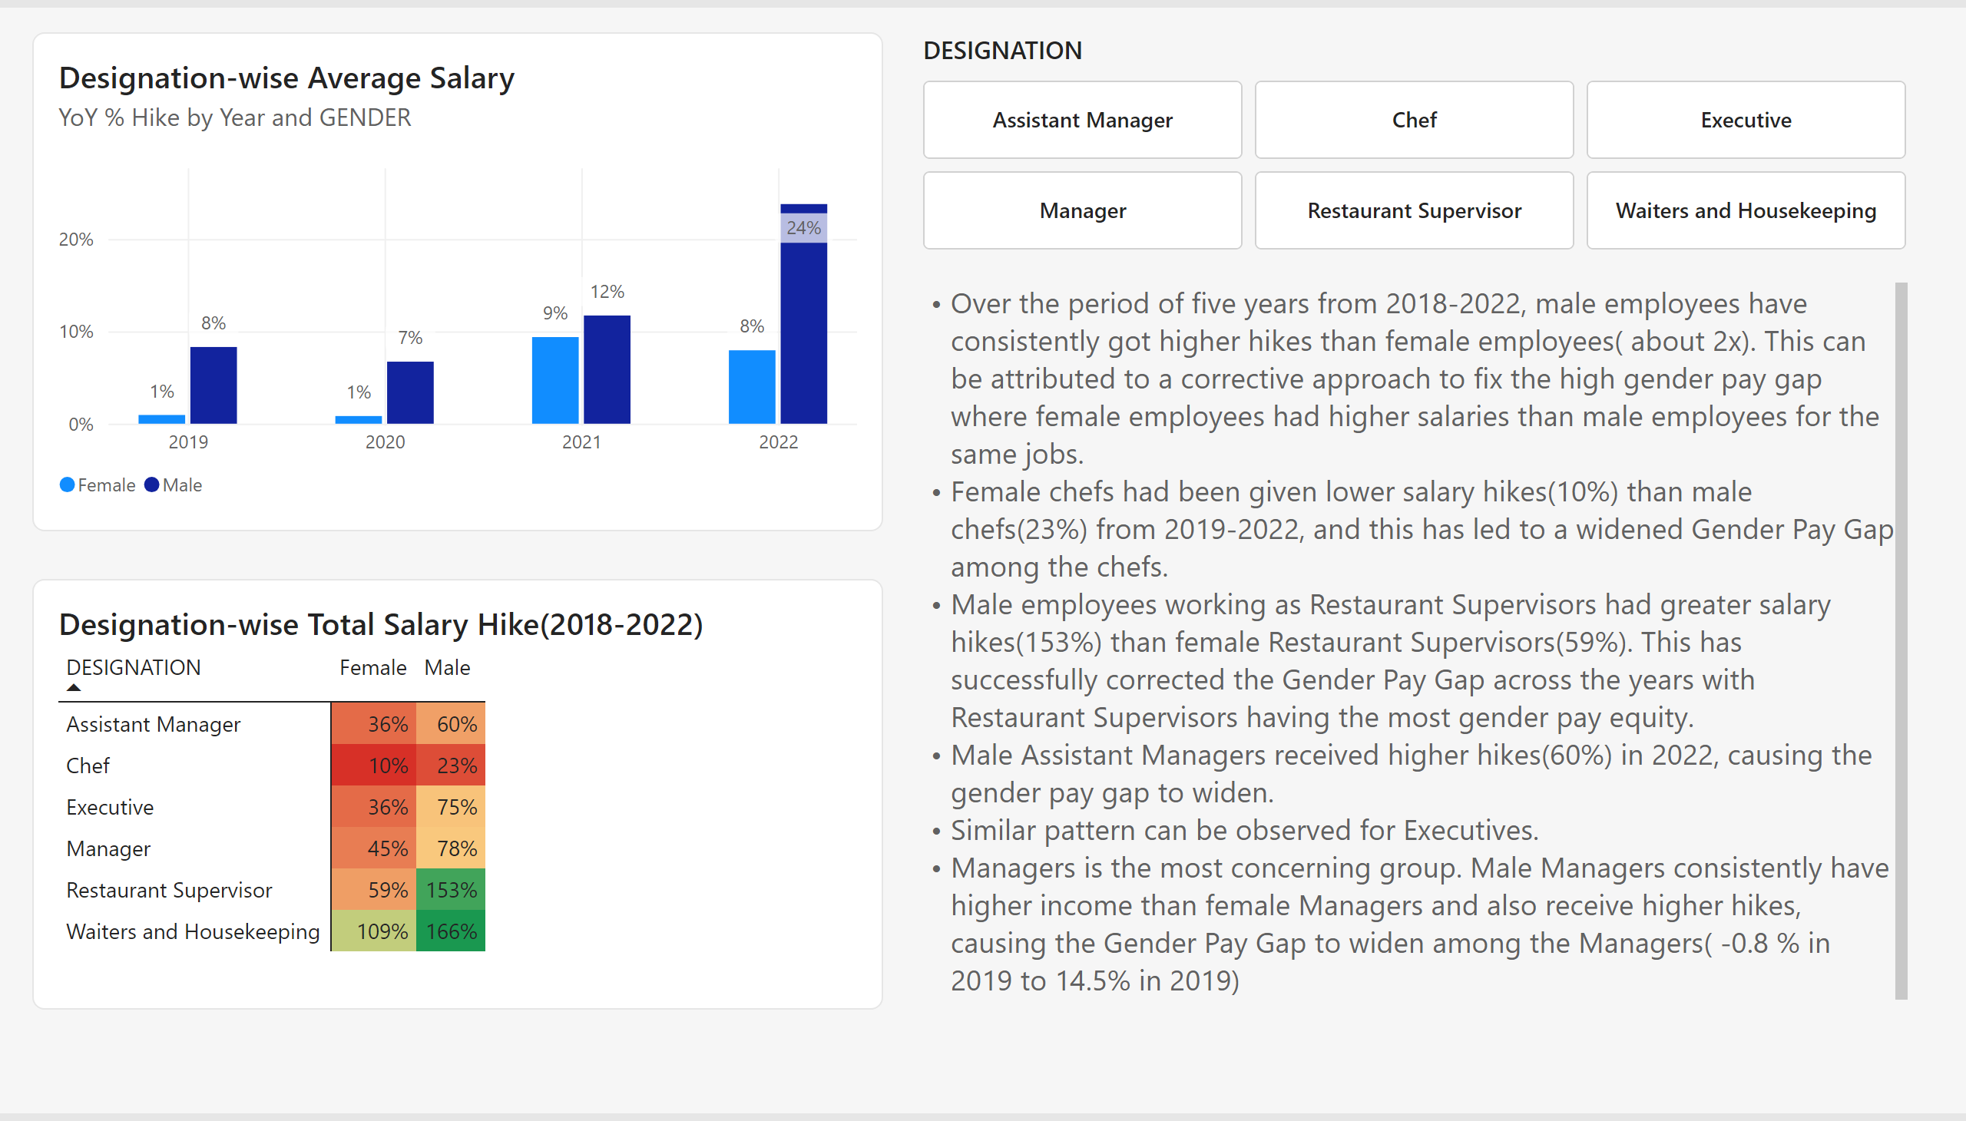
Gender-wise Salary Hike
Notes:
Designation-wise Average Salary
No alt text provided
Designation-wise Total Salary Hike(2018-2022)
No alt text provided
advancedSlicerVisual
No alt text provided
textbox
No alt text provided

Slide 4
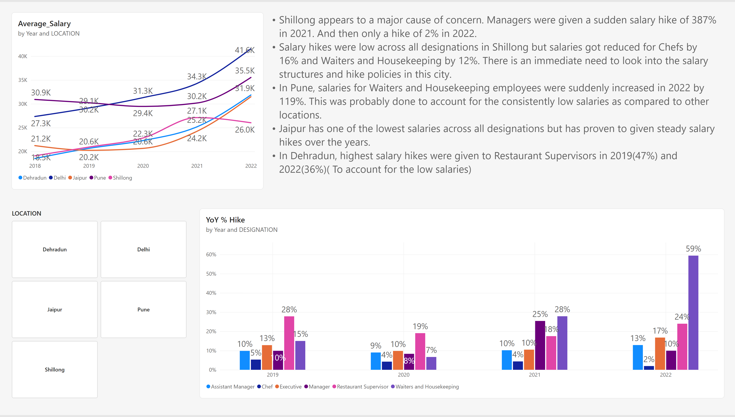
Location-wise Salary Hike
Notes:
lineChart
No alt text provided
advancedSlicerVisual
No alt text provided
clusteredColumnChart
No alt text provided
textbox
No alt text provided

Slide 5
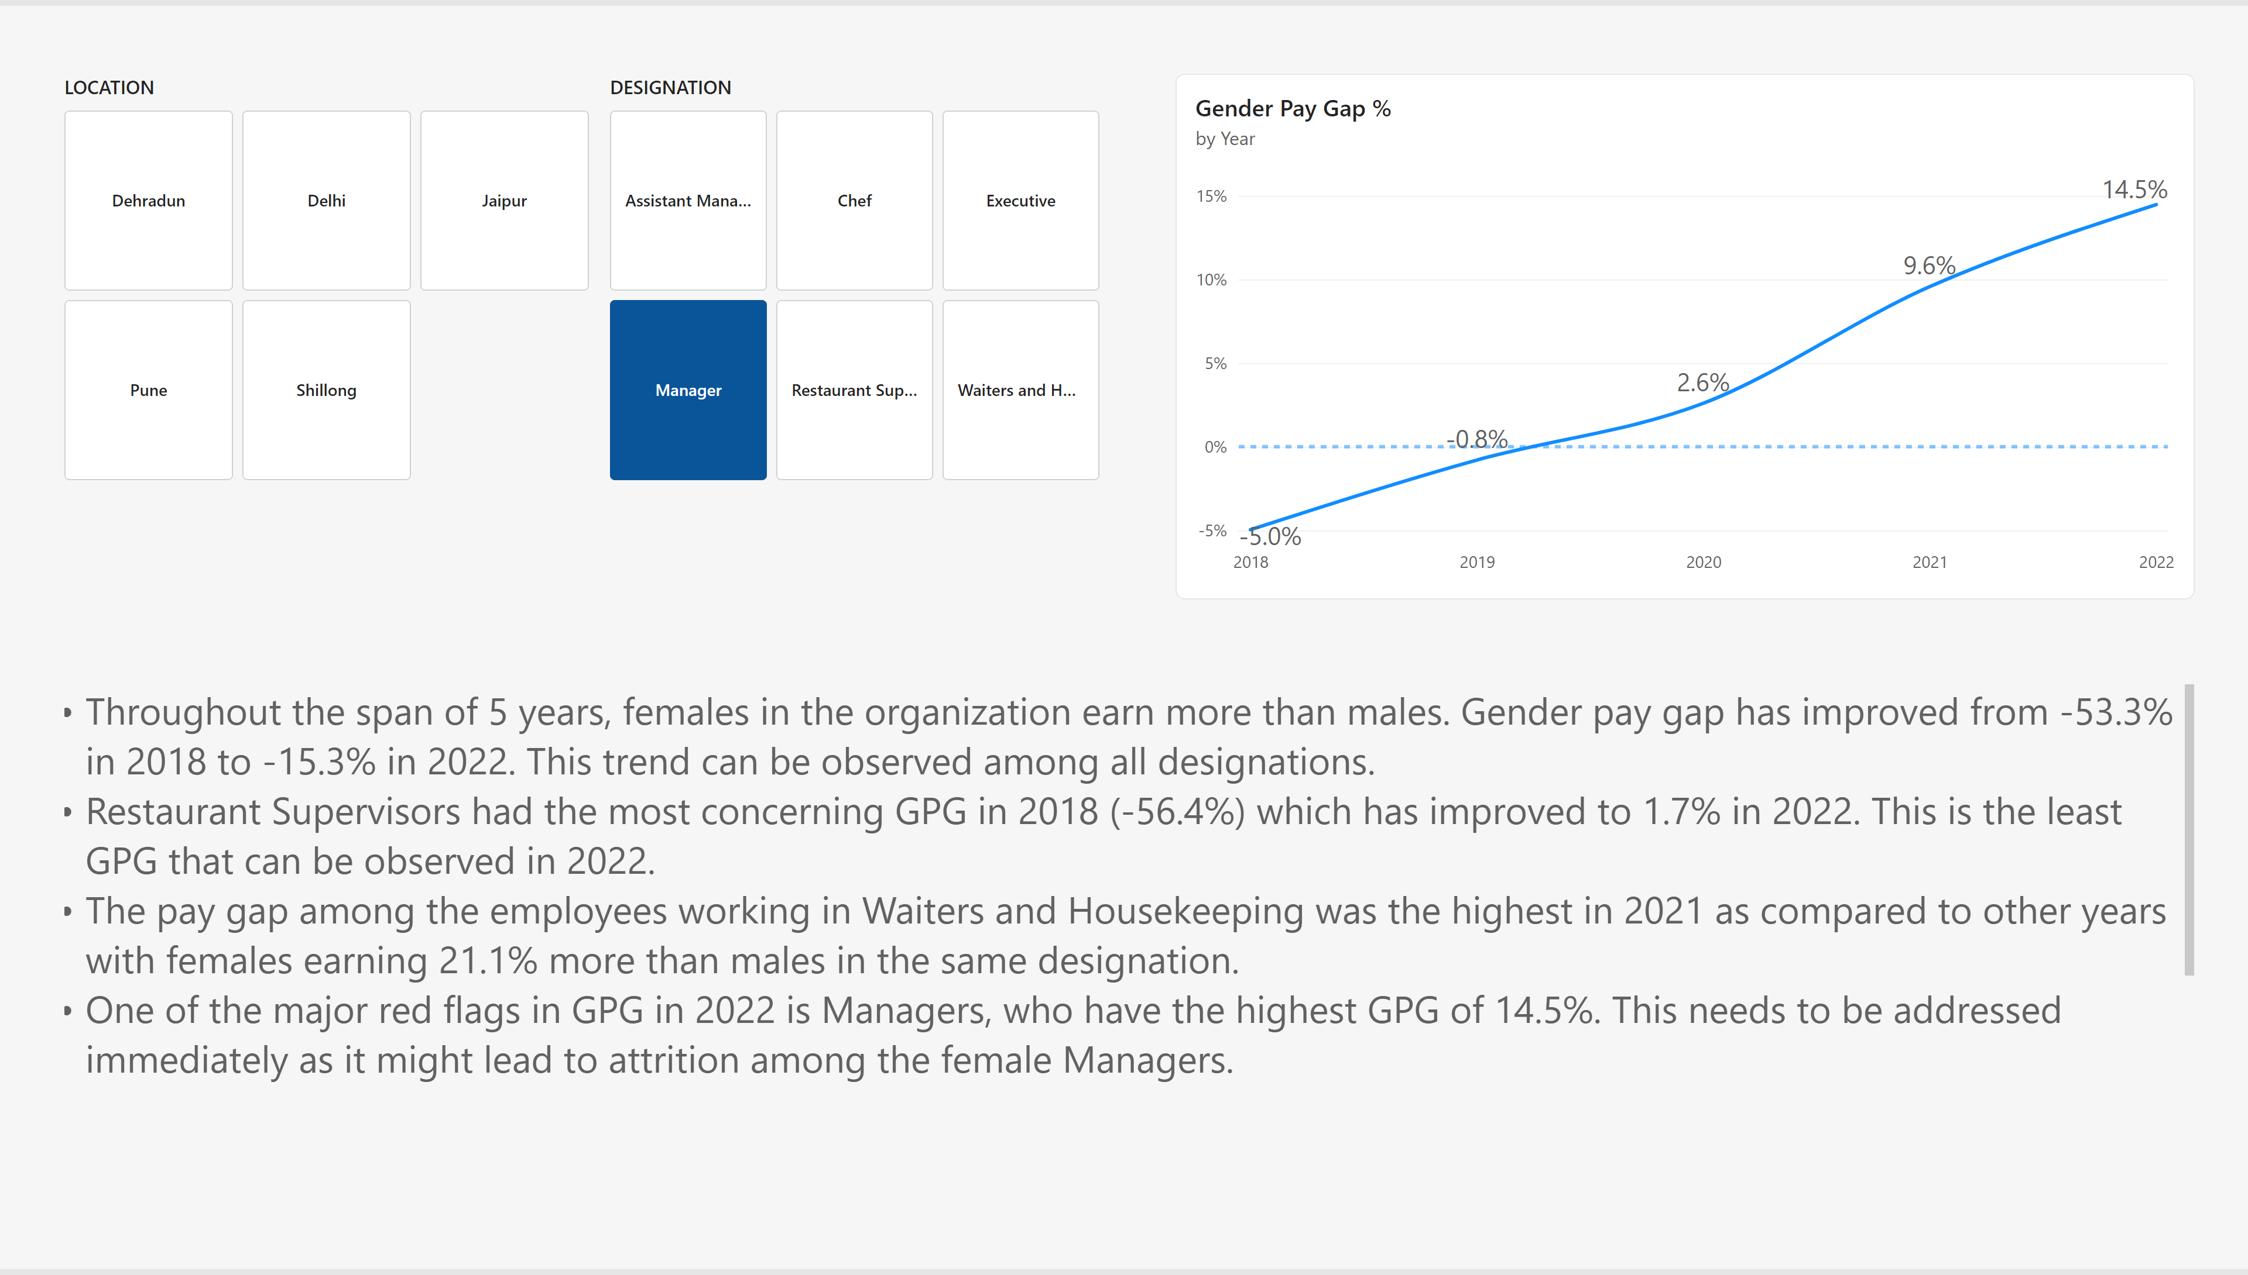
Gender Pay Gap
Notes:
lineChart
No alt text provided
advancedSlicerVisual
No alt text provided
advancedSlicerVisual
No alt text provided
textbox
No alt text provided

Slide 6
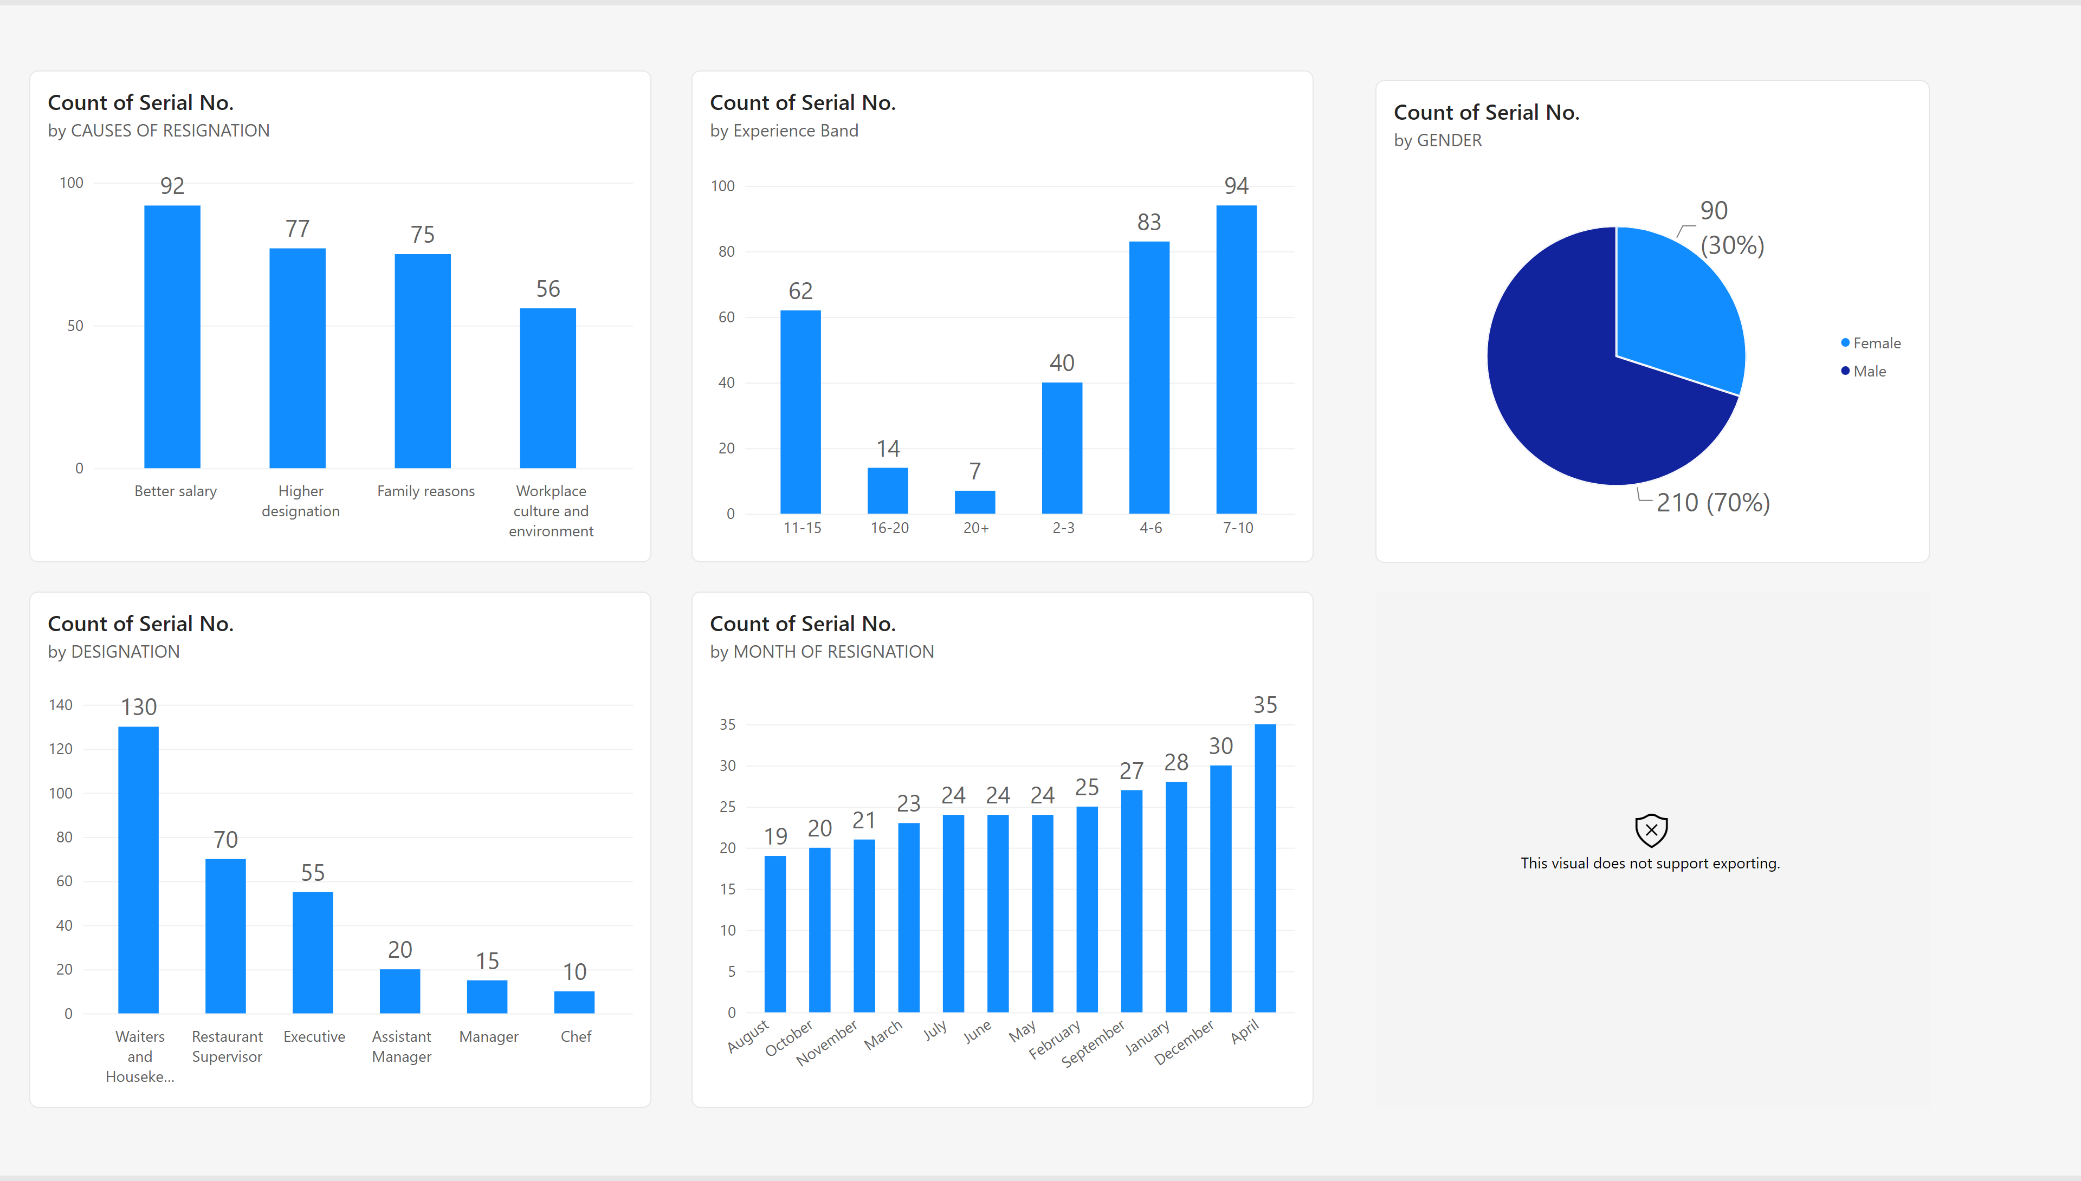
Attrition
Notes:
columnChart
No alt text provided
clusteredColumnChart
No alt text provided
clusteredColumnChart
No alt text provided
clusteredColumnChart
No alt text provided
pieChart
No alt text provided
histogramF963F133BA02A0B35D286F09F80E9C78
No alt text provided

Slide 7
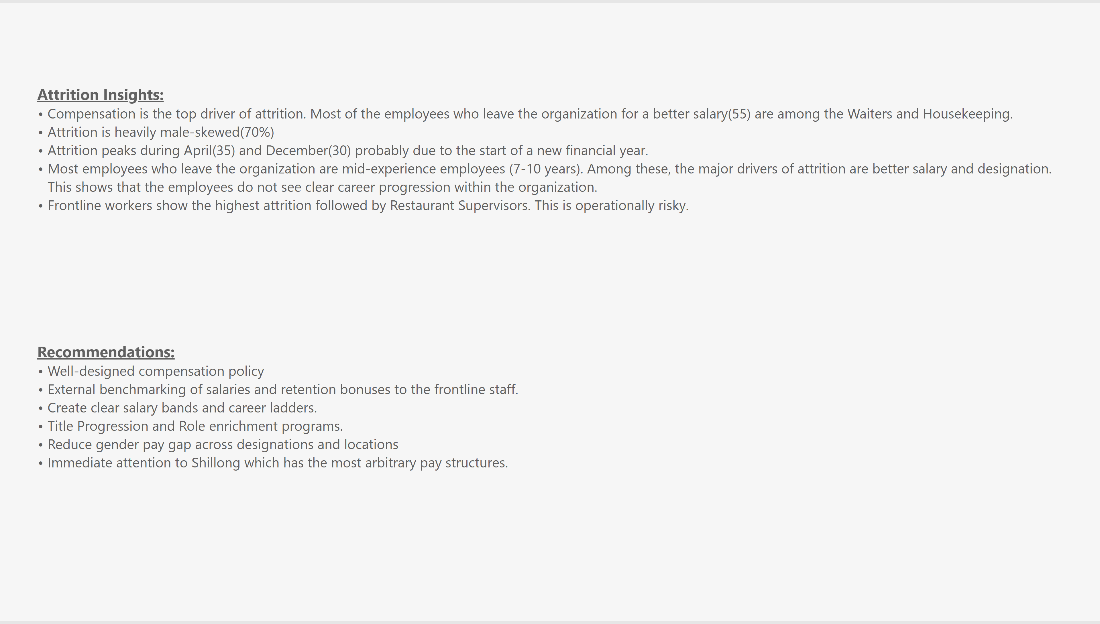
Recommendations
Notes:
textbox
No alt text provided
textbox
No alt text provided

